Slide 1
Everyone has a plan
Sgt Greg Epp
Parker Police Department

Slide 2
Everyone has a plan, until they are punched in the mouth……………….

Slide 3
Mike tyson

Slide 4
The legal side The Why
OSHA and Sarbanes Oxley
OSHA 29 CFR
General Duty Clause
Recognized hazard
Lawsuits
Beneke Family vs Accent Signage
San Bernardino
Rensselaer Polytechnic Institute

Slide 5
What is your plan
What are you doing to prepare?
Emergency Operations Plan (EOP)
Continuity of Operations Plan (COOP)
Threat Hazard Identification and Risk Assessment (THIRA)
When was the last time you updated these
Do they address access and functional needs
Have you ever tested the facility
Training
Buy In

Slide 6
What can you do
The Role of the Facility Manager
Who else knows this role and can perform it
Building Information
Communications Plan
Response plan for the building you are in
Target Hardening
Training
Run Hide Fight, ALICE, C3 Pathways…….
Interdiction Plan

Slide 7
The 88-cent assistant
The simplest of things can make all the difference.
The 3-inch Number or Letter
When time can save lives.

Slide 8
Facility manager
Access Controls
Keys/Cards
Critical Information Distribution
Floor Plans or Maps
Personnel Lists and accountability
Facility Security
What is their Role
Crisis Kits
Medical Kits
Flashlights

Slide 9
reactions
Employees and Customers are likely to follow your lead.
Take Immediate Action
Fight Flight or Freeze
Remain Calm
Panic gets you no where
Secure the facility
What does this look like, is it necessary, how can it be defeated
Evacuate
Multiple locations, partnerships

Slide 10
training
Local Law Enforcement
Local Fire District
Local Emergency Manager
Local School District
Tabletop Exercises
Drills

Slide 11
The very basics
Addresses
Building labels (multiple building locations)
Door Labels
Crime Prevention through Environmental Design (CPTED)
Nighttime
Knowing
Communications
Reverse 911
Code Red
IPAWS

Slide 12
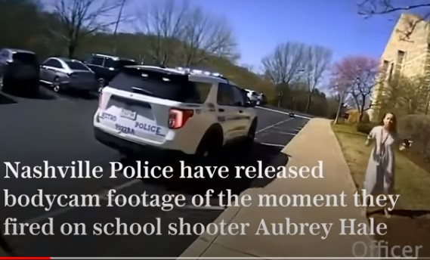
First responders
What to Expect
Initial Contact
What to do
Liaison
What not to do
Interfere
What do you do after the event
Reunification
May not get back into the building
Family
May not get to vehicle
Crime Scene
EAP/ VA

Slide 13
goals
The goal of dealing with any critical incident is to have it resolved to the best possible outcome….No matter who is working at the time.

Slide 14
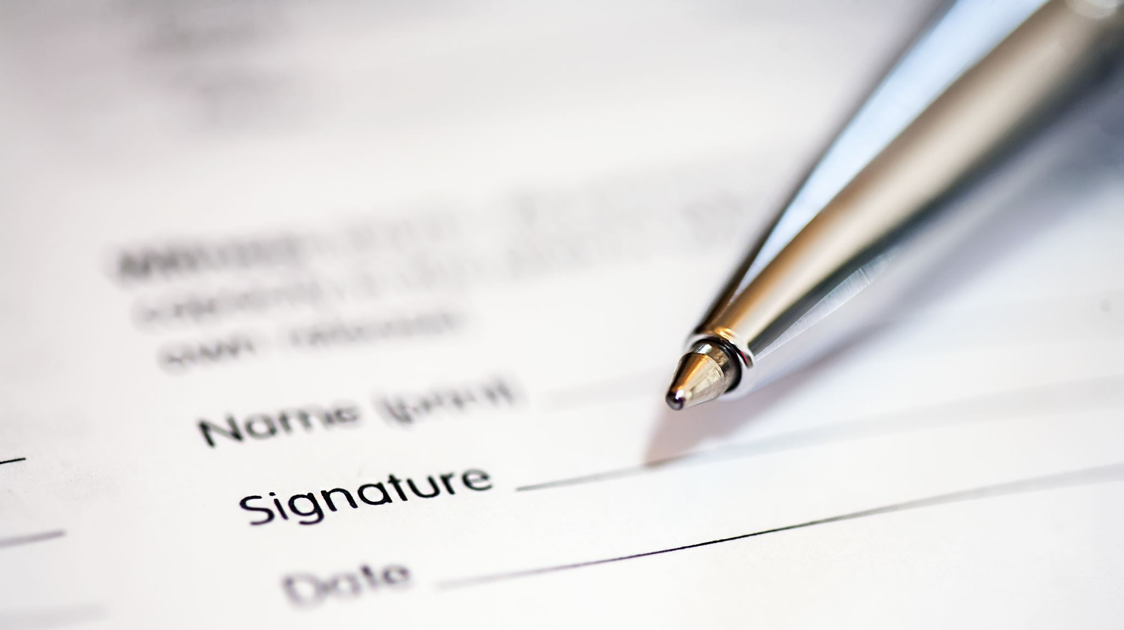
What is your plan……
Resources
FEMA
US Department of Homeland Security
United States Secret Service
Colorado Office of Emergency Management
Local office of Emergency Management
“I Love u guys”
TEEX
LSU

Slide 15
QUESTIONS
Sgt Greg Epp
Parker Police Department
303-805-6532
gepp@parkeronline.org

